Slide 1
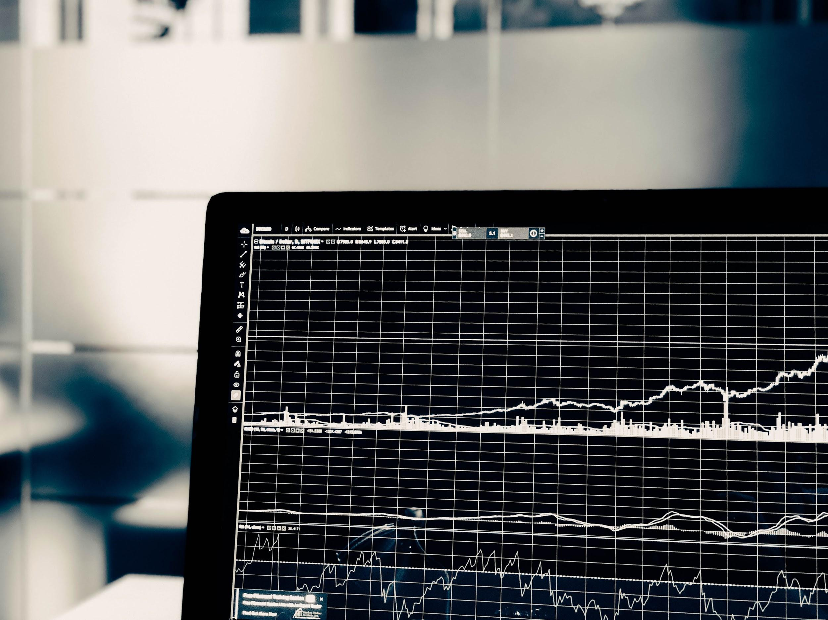
Spandan Gupta Data 606 Capstone Project
Stock Market Prediction using DJIA and Daily News Data

Slide 2
About the data
Top 25 news headlines from Reddit WorldNews Channel is being used to analyze how news headlines can play a part in predicting stock market
Historical Stock data is being sourced from Dow Jones Industrial Average(DJIA). It is a stock market index that measures the stock performance of 30 large companies listed on stock exchanges in the United States.
Referenced Links : https://www.reddit.com/r/worldnews/?hl=
https://finance.yahoo.com/quote/%5EDJI/history?p=%5EDJI

Slide 3
The goal of this project
The idea of this project is to develop a model which can beat the market blues and allow one to make statistically informed trades.
Predict stock prices and carry out an investing research which helps a company understand its stock value and prepare well for monetary exchange between parties.
I plan on executing regression, various classifier techniques, natural language processing and perform a time series analysis. I will also execute artificial neural networks(ANNs), genetic algorithms(GAs) and time delay neural network(TDNN).

